Slide 1
Rebuild the UUL Library : Space Planning
Group 6

Slide 2
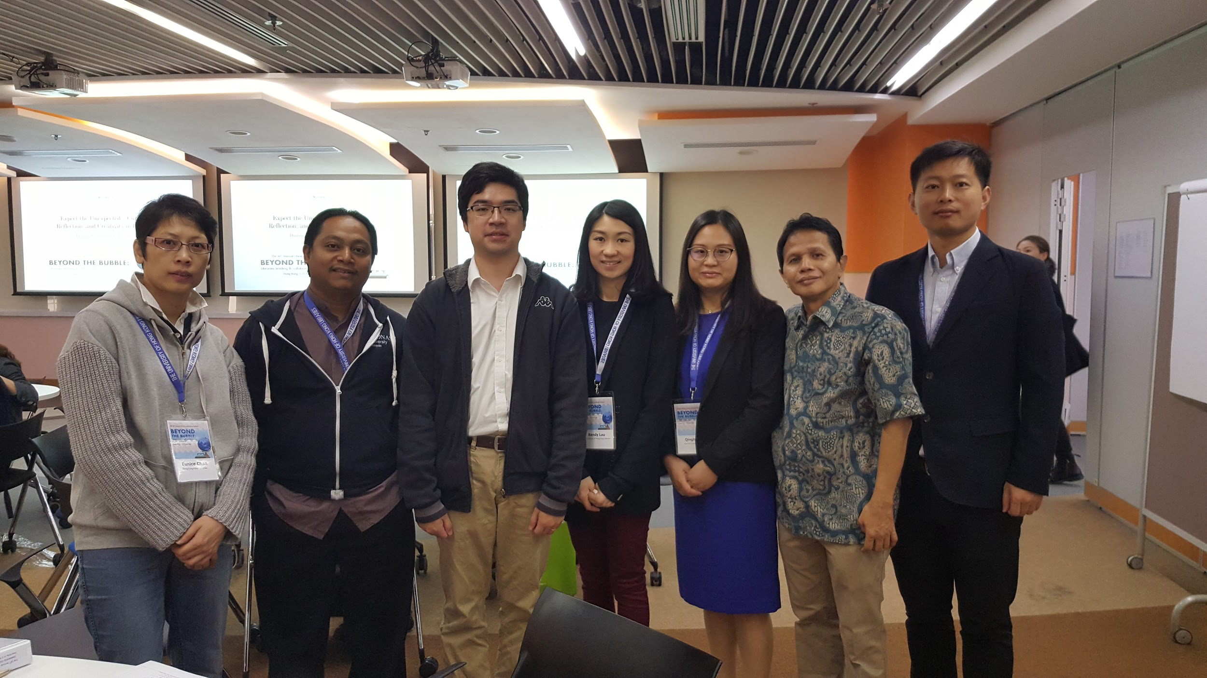
Team Members
Shahril Ali, MUSC
Eunice Chan, HKPLs
Kendy Lau, HKU
Ida Priyanto, GMU
Qinghua Xu, NYU Shanghai
Minjie Yu, ZJU
Wallace Wong, HKBU

Slide 3
Executive Summary
Background
User population: 8,000 undergraduate,1,500 postgraduates, 800 faculty
Building was completed in 1990s
Subject disciplines: Business, Management, Science and Engineering.
Typhoon and flood damaged the library space
Goal
build the library without physical books
support teaching, learning, research and knowledge exchange needs

Slide 4
The Project
Redesign and renovate the lower ground level of the library with a total area of 5,000 square meters, into learning spaces to improve students’ learning experience.

Slide 5
Step-by-Step Planning
1.Form a renovation committee and hire a consultant
2. Hold a student design competition
3. Prototype the design
4. Gather cost estimation
5. Divide the project into multiple phases if the budget is limited
6. Reach out to other consortium libraries for joint purchase opportunities
7. Seek sponsorship
8. Monitor the post-renovation customer satisfaction
Notes:
Involve different stakeholders such as administrators, library and academic staff, undergraduate and graduate students, faculty representative to undertake an assessment of community needs through various means. E.g. survey, interviews, literature review. Next, prepare a plan that includes layout, seating, major design features with design considerations in mind. Decide project timeline
Hold a student design competition for architecture and interior design, and invite faculty from the engineering department to the selection and serve as the advisor
4. Gather cost estimation by consulting with vendors and construction company. E.g. equipment, furnitures, construction cost

Slide 6
Design Considerations
24X7
Flexible Design
Technology Rich
Collaboration
Natural Light
Zoning
Policies and Regulations (building codes, safety, disability access, security, emergency plan)
Notes:
Flexible use design allows you to easily reconfigure a space with the necessary layout, infrastructure, technology, and furniture to accommodate more than one library activity.
Policies and Regulations: comply with building codes, safety codes, consider ways ensure handicapped accessibility, develop Emergency/Evacuation plan.

Slide 7
Basic Amenities
Bathroom Wifi Power outlets Heat, lighting and climate control Security system Water fountain Online Room Reserve System Flexible furnitures Soundproof or noise reduction solution

Slide 8
Zoning
Entrance
Collaborative space
Silent Zone
Food and Drink Area

Slide 9
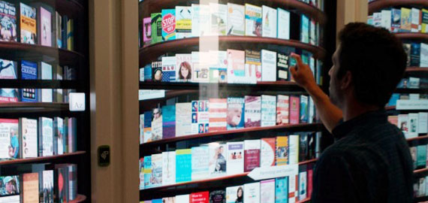
Entrance
Exhibition space (physical and digital)
Designated computers for library research only
Digital bookshelf
Public access computers
Consultation Space
http://www.elizabethtaberlibrary.org/wp-content/uploads/2012/09/Photo-Tour_-Google_s-Surprise-Filled-New-York-City-Office-Including-Digital-Bookshelf.png
Notes:
finding resources in the library catalog, database etc.

Slide 10
Collaborative Space
Active Learning Classroom
Multi-purpose room: closed meeting/interview rooms
Makerspace, Technology lab (3D Printer, AR & VR)
Viewing stations and group viewing room
Video conferencing room
Creation Studio for audio/video production
Library Pavilion

Slide 11
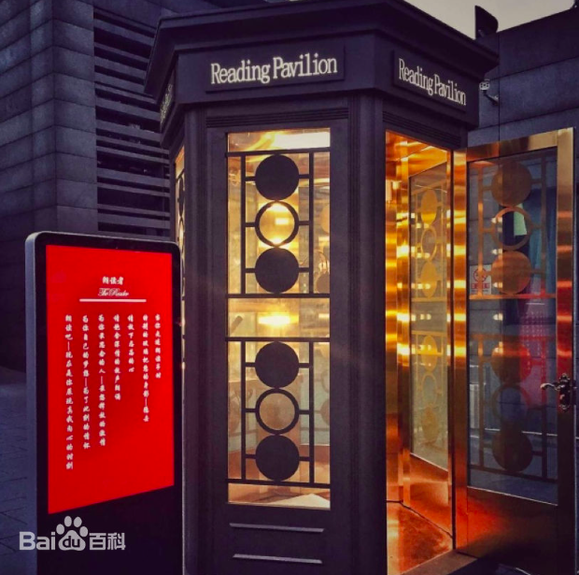
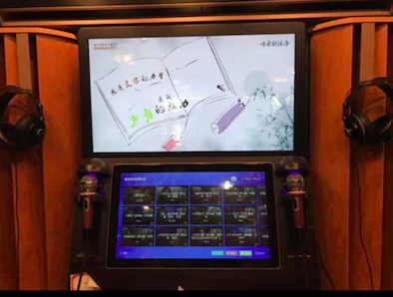
Library Pavilion
Sound Record:
1. for relax: KTV
2. sound insulation
3. Speech record
4. 24 hours service
https://gss0.bdstatic.com/94o3dSag_xI4khGkpoWK1HF6hhy/baike/c0%3Dbaike150%2C5%2C5%2C150%2C50/sign=d4885ae73d9b033b3885f48874a75db6/a2cc7cd98d1001e939a353ecb10e7bec55e797b1.jpg

Slide 12
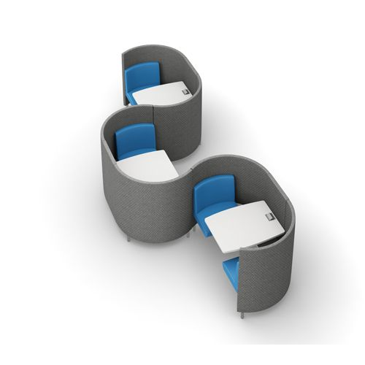
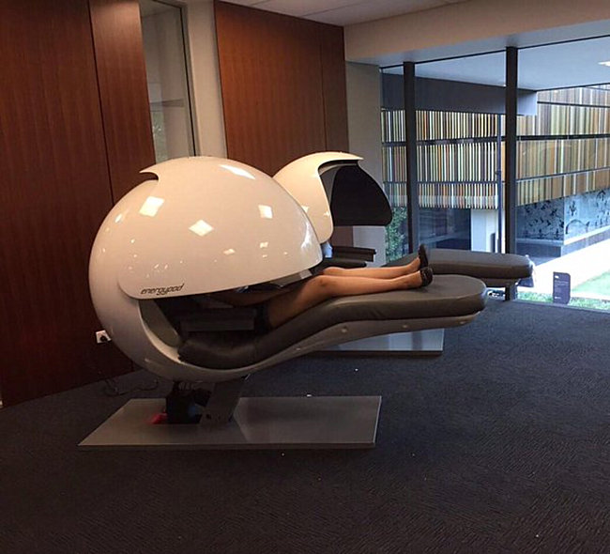
Silent Space
Private study carrel
Napping area
https://cdn.decoist.com/wp-content/uploads/2016/03/Napping-pods-in-the-University-of-Queensland-library-217x155.jpg

Slide 13
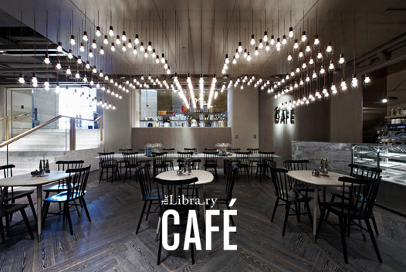
Food and Drink Area
Library Cafe: Run by commercial vendor
Lounge: users can bring their own food
http://www.lanecrawford.com.hk/discover/the-library-caf-4400034-20111101

Slide 14
Challenges
Funding
Maintenance User acceptance of “library without books”
Rapid technology change

